Slide 1
2023-02-06

Slide 2
Unit 7 Test Review

Slide 3
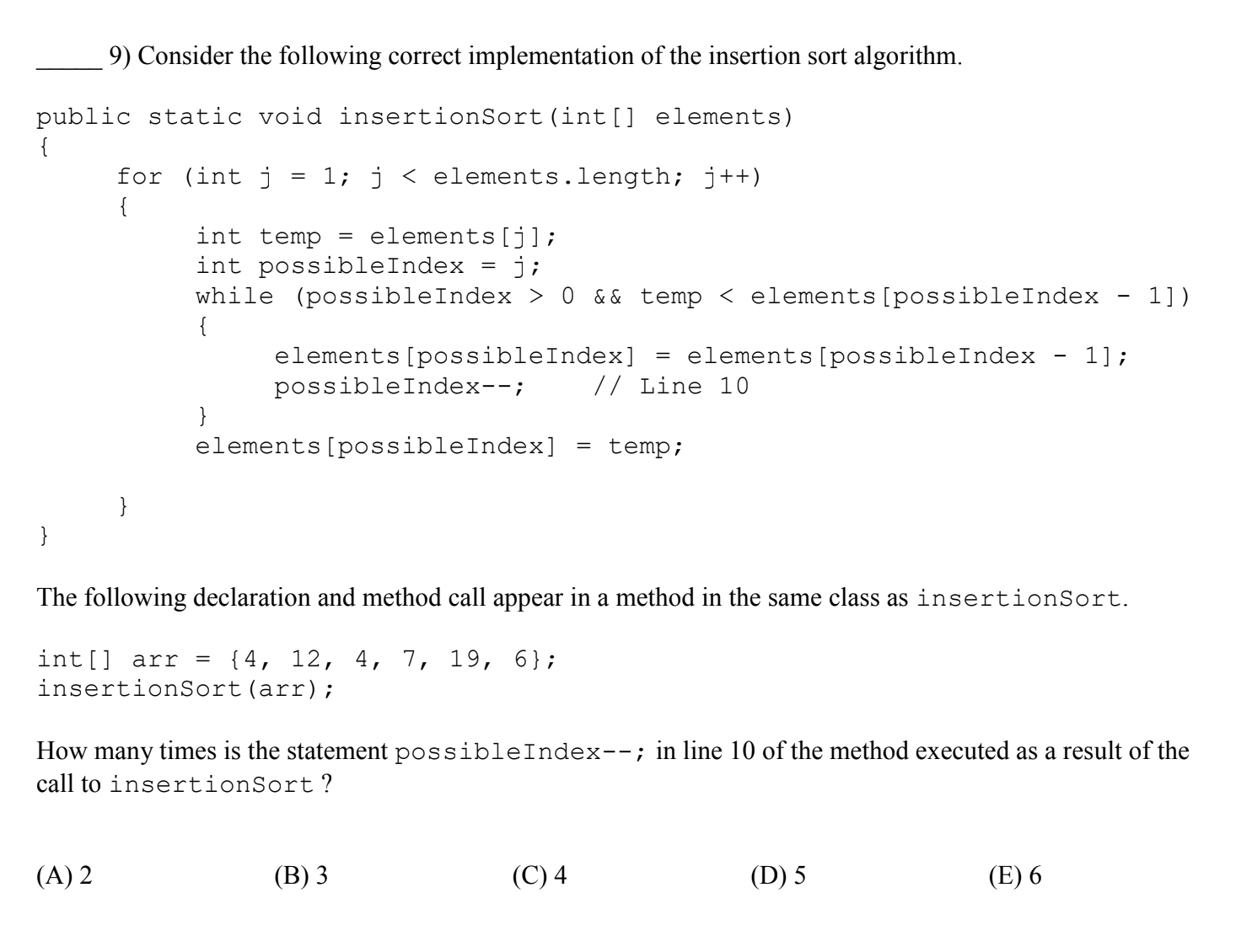

Slide 4
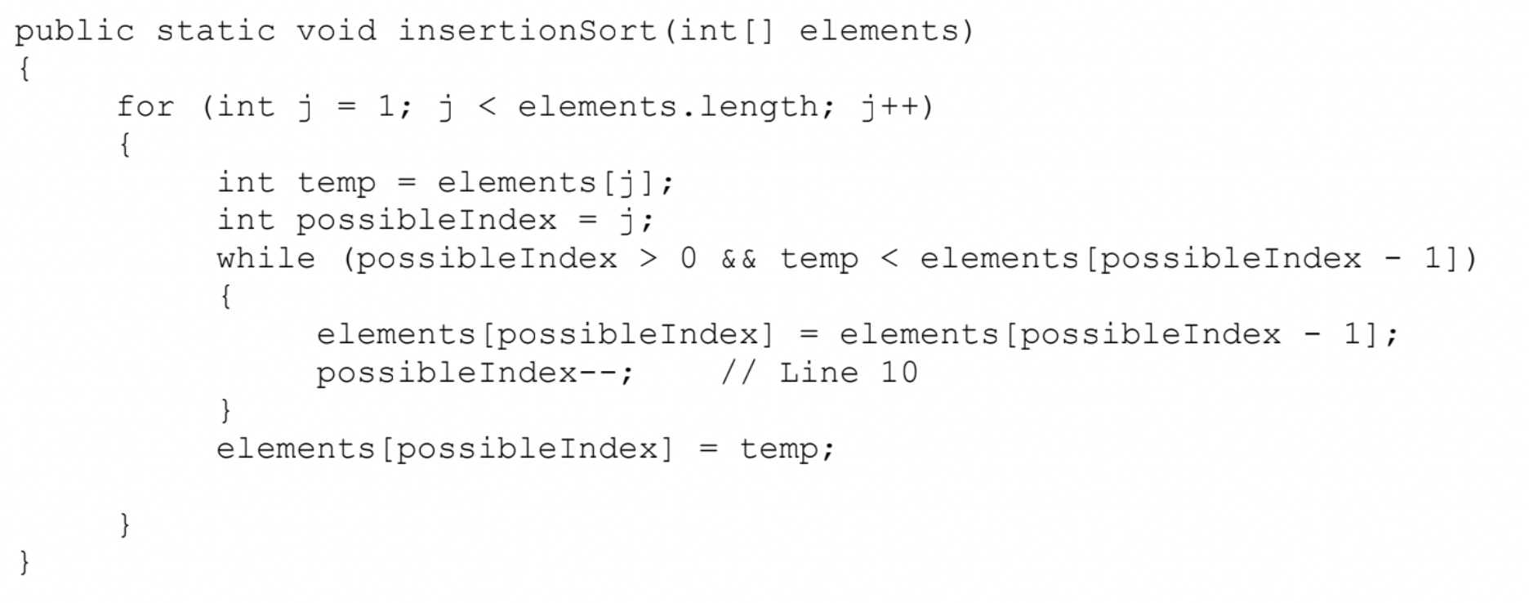
int[] arr = {4, 12, 4, 7, 19, 6};
j=1 {4, 12, 4, 7, 19, 6} a[j]=12
0 swaps
j=2 {4, 12, 4, 7, 19, 6} a[j]=4
1 swap
j =3 {4, 4, 12, 7, 19, 6} a[j]=7
1 swap
j=4 {4, 4, 7, 12, 19, 6} a[j]=19
0 swaps
j=5 {4, 4, 7, 12, 19, 6} a[j]=6
3 swaps
TOTAL - 5 swaps

Slide 5
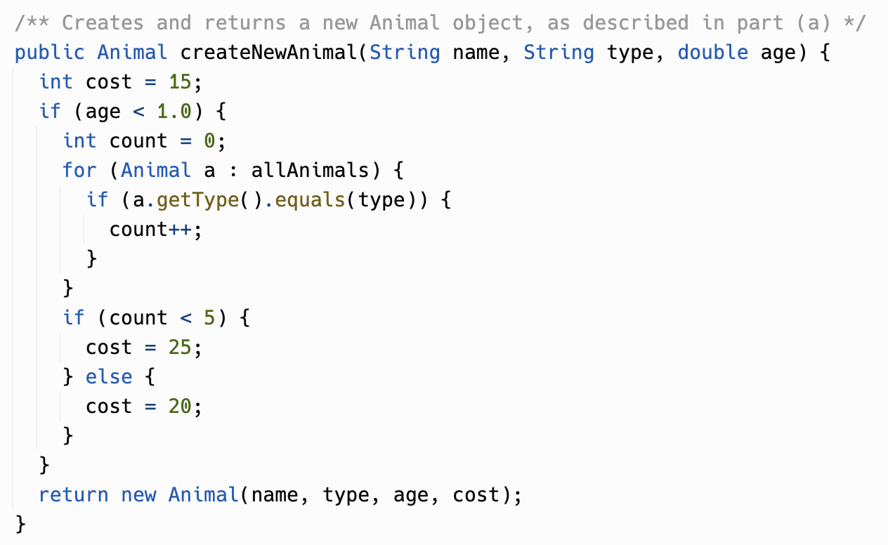
This is not a constructor!
This is an example of the Factory pattern: AnimalShelter knows best how much Animals cost, based on its own state. So the cost "business logic" lives in AnimalShelter, not Animal.
Animal's constructor is probably very simple and just copies its parameters into instance variables.
Some folks noticed you don't have to count up the animals of a certain type if age >= 1.0. Good optimization!

Slide 6
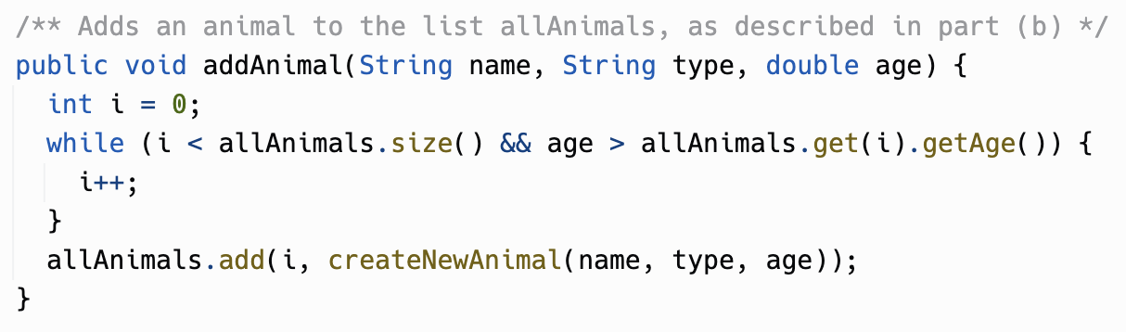
Many folks wrote an Insertion Sort, or even a Selection Sort. Hard to get 100% right! If you're asked an ArrayList question, you CAN bust out ArrayList.add(index, object), and then you just need to find the insertion point, not code a full-blown sort.
Remember that ArrayList.add(0, object) works fine when size == 0. (But ArrayList.set(0, object) does NOT work when size == 0.)

Slide 7
8.2
Traversing
Two-Dimensional Arrays

Slide 8
for loops

Slide 9

Review: Traversing Arrays with for loops
Remember that the range of valid Array indexes (for non-empty Arrays) is 0 to Array.length - 1
int scores[] = {95, 100, 91, 85 };
for (int idx = 0; idx < scores.length; idx++) {
System.out.println(scores[idx]);
}

Slide 10

Review: Traversing Arrays with for loops
Remember that the range of valid Array indexes (for non-empty Arrays) is 0 to Array.length - 1
int scores[] = {95, 100, 91, 85 };
for (int idx = 0; idx < scores.length; idx++) {
System.out.println(scores[idx]);
}
int scores[] = {95, 100, 91, 85 };
for (int idx = 1; idx <= scores.length; idx++) {
System.out.println(scores[idx]);
}

Slide 11
Review: Traversing Arrays with for loops
Remember that the range of valid Array indexes (for non-empty Arrays) is 0 to Array.length - 1
int scores[] = {95, 100, 91, 85 };
for (int idx = 0; idx < scores.length; idx++) {
System.out.println(scores[idx]);
}
int scores[] = {95, 100, 91, 85 };
for (int idx = 1; idx <= scores.length; idx++) {
System.out.println(scores[idx]);
}
Note: Passing an out of range index will cause a ArrayIndexOutOfBoundsException!

Slide 12
Review: Traversing Arrays with for loops
Remember that the range of valid Array indexes (for non-empty Arrays) is 0 to Array.length - 1
int scores[] = {95, 100, 91, 85 };
for (int idx = 0; idx < scores.length; idx++) {
System.out.println(scores[idx]);
}
This loop also skips the first element in the Array!
int scores[] = {95, 100, 91, 85 };
for (int idx = 1; idx <= scores.length; idx++) {
System.out.println(scores[idx]);
}
Note: Passing an out of range index will cause a ArrayIndexOutOfBoundsException!

Slide 13
Review: Traversing Arrays with for loops
You can use a for loop to traverse an Array from back to front!
int scores[] = {95, 100, 91, 85 };
for (int idx = scores.length - 1; idx >= 0; idx--) {
System.out.println(scores[idx]);
}
...or to traverse any arbitrary range of elements
int scores[] = {95, 100, 91, 85 };
for (int idx = 1; idx <= 2; idx++) {
System.out.println(scores[idx]);
}

Slide 14
Traversing Two-Dimensional Arrays with for loops
Traversing Two-Dimensional Arrays is very similar
int scores[ ][ ] = { {10,20,30},{40,50,60} };
for (int idx = 0; idx < scores.length; idx++) { for (int jdx = 0; jdx < scores[idx].length; jdx++) {
System.out.println(scores[idx][jdx]); }
}

Slide 15
Traversing Two-Dimensional Arrays with for loops
Traversing Two-Dimensional Arrays is very similar
int scores[ ][ ] = { {10,20,30},{40,50,60} };
for (int idx = 0; idx < scores.length; idx++) { for (int jdx = 0; jdx < scores[idx].length; jdx++) {
System.out.println(scores[idx][jdx]); }
}
Typically start at index = 0
& don't exceed length-1

Slide 16
Traversing Two-Dimensional Arrays with for loops
Traversing Two-Dimensional Arrays is very similar
int scores[ ][ ] = { {10,20,30},{40,50,60} };
for (int idx = 0; idx < scores.length; idx++) { for (int jdx = 0; jdx < scores[idx].length; jdx++) {
System.out.println(scores[idx][jdx]); }
}
Typically start at index = 0
& don't exceed length-1
Note: Passing an out of range index will cause a ArrayIndexOutOfBoundsException!

Slide 17
for-each loops

Slide 18
Review: Traversing Arrays with for-each loops
for (type arrayItemVariable : arrayVariable) { arrayItemVariable resolves to arrayVariable[...] }
String[] colors = {"red", "orange", "purple"}; System.out.println("begin"); for(String color: colors){ System.out.println(" " + color); } System.out.println("end");

Slide 19
Review: Traversing Arrays with for-each loops
The type of the for-each variable MUST match the type of the values stored in the Array
String colors[] = {"red", "orange", "purple"}; for(int color: colors){ System.out.println(" " + color); }

Slide 20
Review: Traversing Arrays with for-each loops
The type of the for-each variable MUST match the type of the values stored in the Array
String colors[] = {"red", "orange", "purple"}; for(int color: colors){ System.out.println(" " + color); }
Note: color must be of type String since colors is an Array that contains Strings

Slide 21
Traversing Two-Dimensional Arrays with for-each loops
Remember during the introduction of Two-Dimensional Arrays - We said: "Arrays are a type - Which means you can easily create an Array that contains Arrays - often called Two-Dimensional Arrays"
That means we can use for-each to traverse a Two-Dimensional Array almost exactly like a One-Dimensional Array (we just have to be careful how we declare the types)

Slide 22
Traversing Two-Dimensional Arrays with for-each loops
Remember during the introduction of Two-Dimensional Arrays - We said: "Arrays are a type - Which means you can easily create an Array that contains Arrays - often called Two-Dimensional Arrays"
That means we can use for-each to traverse a Two-Dimensional Array almost exactly like a One-Dimensional Array (we just have to be careful how we declare the types)
Reminder: for-each loops can be super-useful; but you are unable to make use of an index or change the underlying Array while looping

Slide 23
Traversing Two-Dimensional Arrays with for-each loops
Given this Two-Dimensional Array
int scores[][] = {{10,20,30},{40,50,60}};
And this general description of for-each
for (type arrayItemVariable : arrayVariable) { arrayItemVariable resolves to Array[...] }
Q: What is the type of the outer array in scores?

Slide 24
Traversing Two-Dimensional Arrays with for-each loops
Given this Two-Dimensional Array
int scores[][] = {{10,20,30},{40,50,60}};
And this general description of for-each
for (type arrayItemVariable : arrayVariable) { arrayItemVariable resolves to Array[...] }
Q: What is the type of the outer array in scores?
scores[] -> an array of int[]

Slide 25
Traversing Two-Dimensional Arrays with for-each loops
Given this Two-Dimensional Array
int scores[][] = {{10,20,30},{40,50,60}};
And this general description of for-each
for (type arrayItemVariable : arrayVariable) { arrayItemVariable resolves to Array[...] }
Q: What is the type of the outer array in scores?
scores[] -> an array of int[]
Q: What is the type of the inner array in scores?

Slide 26
Traversing Two-Dimensional Arrays with for-each loops
Given this Two-Dimensional Array
int scores[][] = {{10,20,30},{40,50,60}};
And this general description of for-each
for (type arrayItemVariable : arrayVariable) { arrayItemVariable resolves to Array[...] }
Q: What is the type of the outer array in scores?
scores[] -> an array of int[]
Q: What is the type of the inner array in scores?
scores[][] -> an array of int

Slide 27
Traversing Two-Dimensional Arrays with for-each loops
int scores[][] = {{10,20,30},{40,50,60}};
scores[] -> an array of int[] scores[][] -> an array of int
So we can use for-each to traverse the Two-Dimensional Array like this
for (int[] outer : scores) {
for (int inner : outer) {
System.out.println(inner);
} }

Slide 28
Traversing Two-Dimensional Arrays with for-each loops
int scores[][] = {{10,20,30},{40,50,60}};
scores[] -> an array of int[] scores[][] -> an array of int
So we can use for-each to traverse the Two-Dimensional Array like this
for (int[] outer : scores) {
for (int inner : outer) {
System.out.println(inner);
} }
Note: The inner array is a One-Dimensional Array - So we use the same for-each that we used previously for One-Dimensional Arrays
for (type arrayItemVariable : arrayVariable) { arrayItemVariable resolves to arrayVariable[...] }

Slide 29
Traversing Two-Dimensional Arrays with for-each loops
int scores[][] = {{10,20,30},{40,50,60}};
scores[] -> an array of int[] scores[][] -> an array of int
So we can use for-each to traverse the Two-Dimensional Array like this
for (int[] outer : scores) {
for (int inner : outer) {
System.out.println(inner);
} }
Note: The inner array is a One-Dimensional Array - So we use the same for-each that we used previously for One-Dimensional Arrays
for (type arrayItemVariable : arrayVariable) { arrayItemVariable resolves to arrayVariable[...] }
No indices available for use!

Slide 30
Traversal of Jagged Arrays
Traversal of Two-Dimensional Jagged Arrays works the same!
int jaggedTable[][] = new int[3][]; jaggedTable[0] = new int[]{4,1,5,9,6,3}; jaggedTable[1] = new int[]{9,1}; jaggedTable[2] = new int[]{0,3,2,9,4};
4
1
5
9
6
3
9
1
0
3
2
9
4

Slide 31
Traversal of Jagged Arrays
Traversal of Two-Dimensional Jagged Arrays works the same!
int jaggedTable[][] = new int[3][]; jaggedTable[0] = new int[]{4,1,5,9,6,3}; jaggedTable[1] = new int[]{9,1}; jaggedTable[2] = new int[]{0,3,2,9,4}; for (int idx = 0; idx < jaggedTable.length; idx++) { for (int jdx = 0; jdx < jaggedTable[idx].length; jdx++) { System.out.print(jaggedTable[idx][jdx] + " "); } System.out.println(); }
4
1
5
9
6
3
9
1
0
3
2
9
4

Slide 32
Example: Basketball Scores
int NUM_PLAYERS = 5, NUM_GAMES = 3; int scores[][] = new int[NUM_PLAYERS][NUM_GAMES];
 | Game 1 | Game 2 | Game 3
Player 1 | 14 | 19 | 22
Player 2 | 24 | 13 | 5
Player 3 | 5 | 26 | 31
Player 4 | 0 | 18 | 40
Player 5 | 15 | 9 | 46

Slide 33
Example: Basketball Scores
int NUM_PLAYERS = 5, NUM_GAMES = 3; int scores[][] = new int[NUM_PLAYERS][NUM_GAMES];
scores[][]
 | Game 1 | Game 2 | Game 3
Player 1 | 14 | 19 | 22
Player 2 | 24 | 13 | 5
Player 3 | 5 | 26 | 31
Player 4 | 0 | 18 | 40
Player 5 | 15 | 9 | 46

Slide 34
Example: Basketball Scores
int NUM_PLAYERS = 5, NUM_GAMES = 3; int scores[][] = new int[NUM_PLAYERS][NUM_GAMES];
scores[3][0], scores[3][1], scores[3][2]
 | Game 1 | Game 2 | Game 3
Player 1 | 14 | 19 | 22
Player 2 | 24 | 13 | 5
Player 3 | 5 | 26 | 31
Player 4 | 0 | 18 | 40
Player 5 | 15 | 9 | 46

Slide 35
Example: Basketball Scores
int NUM_PLAYERS = 5, NUM_GAMES = 3; int scores[][] = new int[NUM_PLAYERS][NUM_GAMES];
scores[0][1], scores[1][1], scores[2][1], scores[3][1], scores[4][1]
 | Game 1 | Game 2 | Game 3
Player 1 | 14 | 19 | 22
Player 2 | 24 | 13 | 5
Player 3 | 5 | 26 | 31
Player 4 | 0 | 18 | 40
Player 5 | 15 | 9 | 46

Slide 36
Example: Basketball Scores
int NUM_PLAYERS = 5, NUM_GAMES = 3; int scores[][] = new int[NUM_PLAYERS][NUM_GAMES];
 | Game 1 | Game 2 | Game 3
Player 1 | 14 | 19 | 22
Player 2 | 24 | 13 | 5
Player 3 | 5 | 26 | 31
Player 4 | 0 | 18 | 40
Player 5 | 15 | 9 | 46
Q1: How would you determine the total points scored by all 5 players in all 3 games?
Q2: How would you determine which player had the highest number of points in Game 3?
Q3: How would you determine the average points scored by Player 3 in all 3 games?

Slide 37
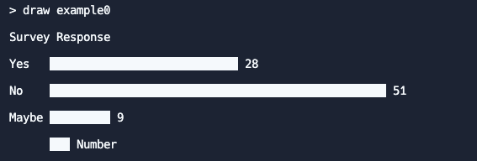
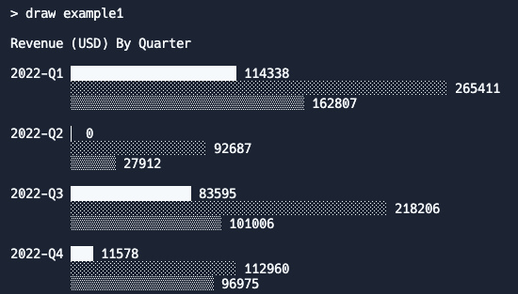
Practice on your own
CSAwesome 8.2 - Two-Dimensional Arrays
Replit - Chart Render
Provide function bodies for
Chart.getMaxSegmentTotal()
Chart.getMaxRowLabelWidth()
Chart.adjustFillBlocks()
Two charts are pre-created into memory; Draw them using the draw command
draw example0
draw example1
Additional charts can be loaded from the chart_data_files directory using the load command
load population-usa.txt
load population-usa-age.txt
What other capabilities can you add?

